Slide 1
Engineer Student Championship
Employer branding & talent recruitment
Engineer Student Championship page 2
Sponsoring packages page 12
EcoSim competitions, references page 13
Contact page 16

Slide 2
Engineer Student Championship
Employer branding & talent recruitment
2

Slide 3
Engineer Student Championship
Employer branding & recruitment
Effective reach of the mechanical and electric engineer students
CV database of ~350 engineer students
Recruitment of motivated young engineers
Performance based talent acquisition
Development and assessment of engineer knowledge & skills
The game engine can be applied as gamification selection tool of applicants

Slide 4
Engineer Student Championship
Message:
„Experience the work and the corporate culture of the best engineer employers! Show your talent and persistance solving exciting engineer case studies and win great prizes and career opportunity!”
Employer branding and recruitment goals:
To show the career opportunities and the EVP statement of the Sponsor
Assess of the important skills and knowledge; talent discovery
Recruitment of interns, colleagues from the participants
Talent network, community building: creating or enlarging the number of potential employees
Providing experience, fun, positive impression to make the company more attractive

Slide 5
Engineer Student Championship
Marketing campaign
Target: 350-400 participants
Posters, brochures* 2 500
Mailing lists: ~25 000 persons.
Roadshow (4-6 locations)
20 Student Brand Manager
Social group & ads
Local school media
Search Engine Optimization
Professors
** We use recycled paper only

Slide 6
EcoSim Student Brand Manager Network

Slide 7
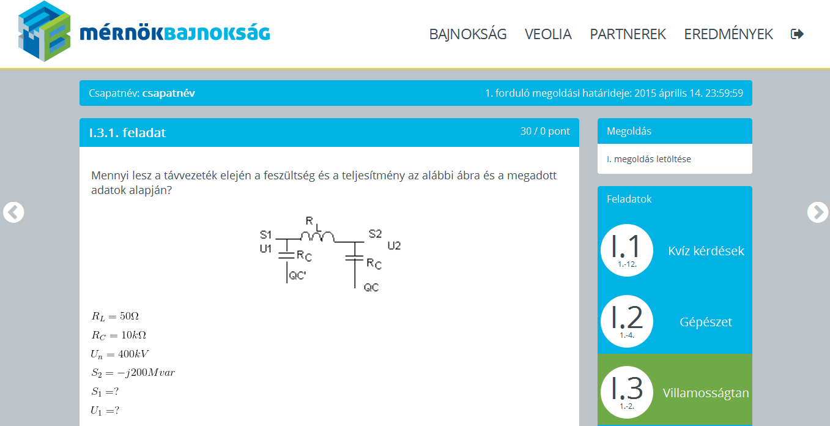
Engineer Student Championship
Online qualification rounds:
The case studies and quiz questions of the qualification is determined by the Sponsors of the competition.
The tasks are implemented into the online game surface of the Championship.
Each gold and silver sponsor has its own round in the qualification.

Slide 8
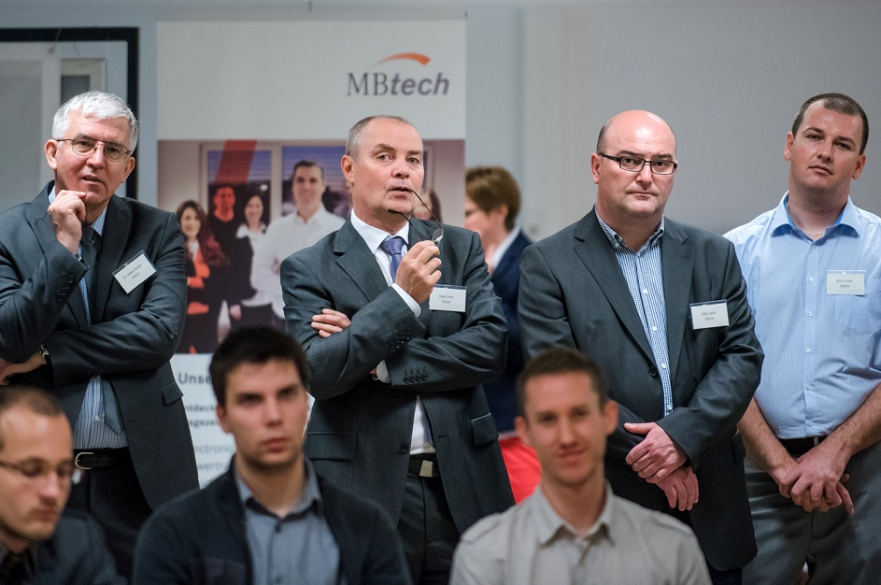
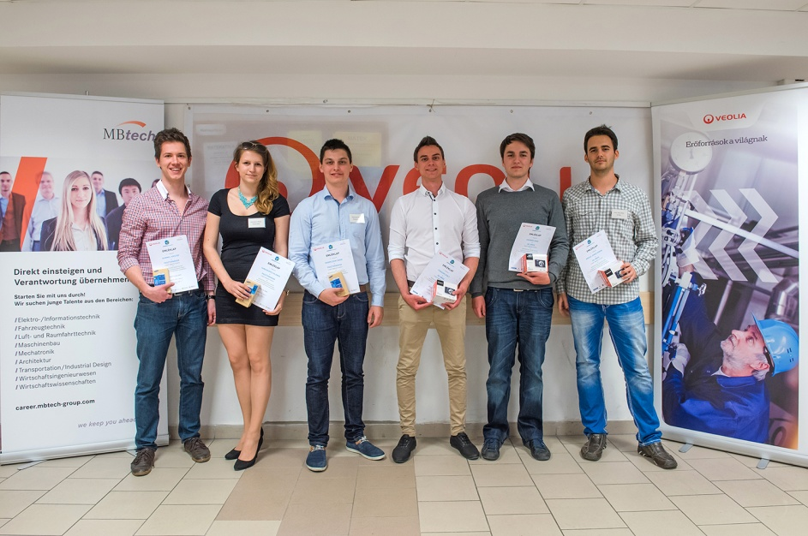
Engineer Student Championship
The Live Final
The Final is a one day event, the most exciting part of the competition. The best 10 teams, 30 persons will be challenged with tasks, for example engineer problem solving and presentation.
Sponsors organize interactive company presentations, games during the Final.
The last steps are the prizing ceremony, the interview with the Sponsors and the best teams, photo making and a closing reception.
The location can be the HQ of the Gold Sponsor company or at an independent location.

Slide 9
Engineer Student Championship
Timing
August
Sept
Oct
Nov
Dec
Preparing
Website development
Task development & testing
Marketing campaign
Online rounds
Final
Company events
Red: active contribution of the Sponsors’ colleagues is necessary
9

Slide 10
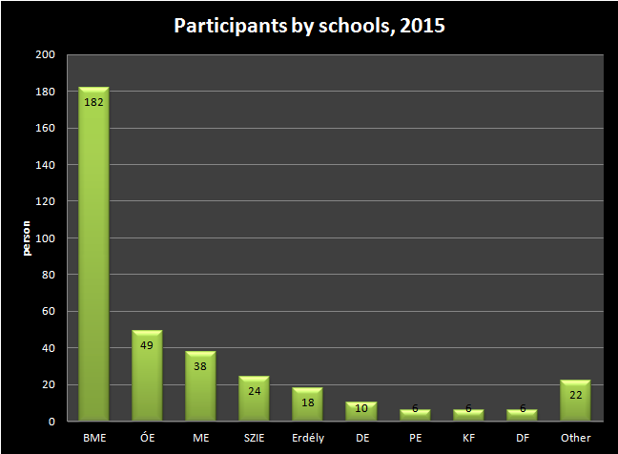

Slide 11
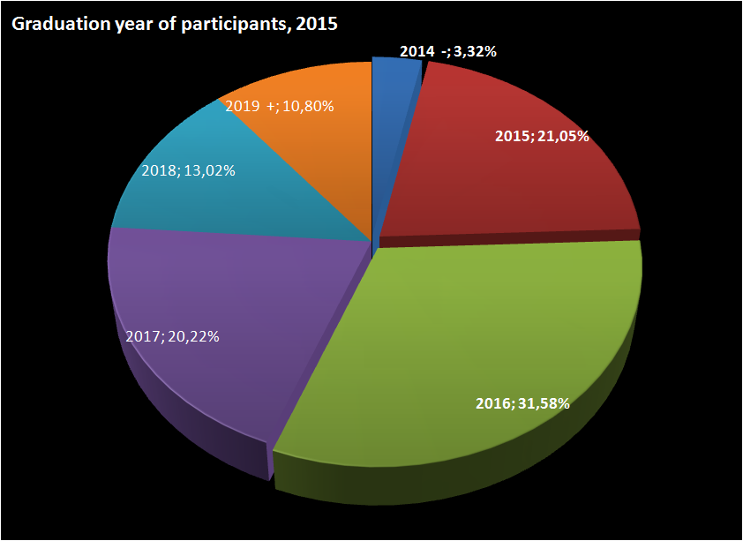
11/11

Slide 12
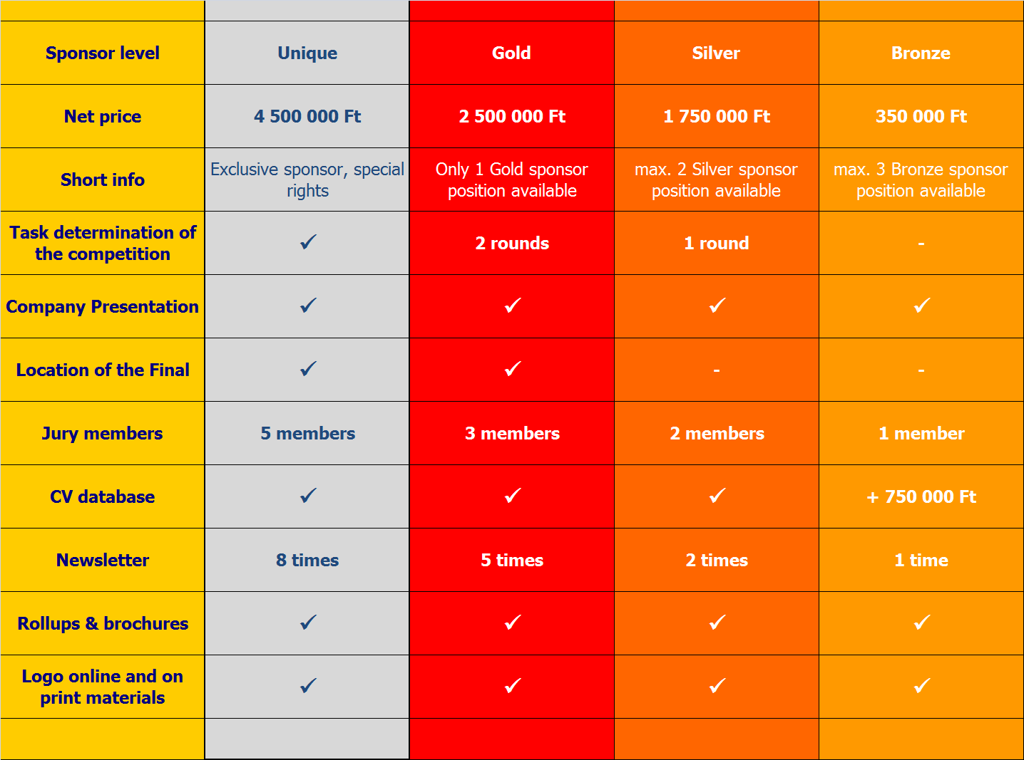

Slide 13
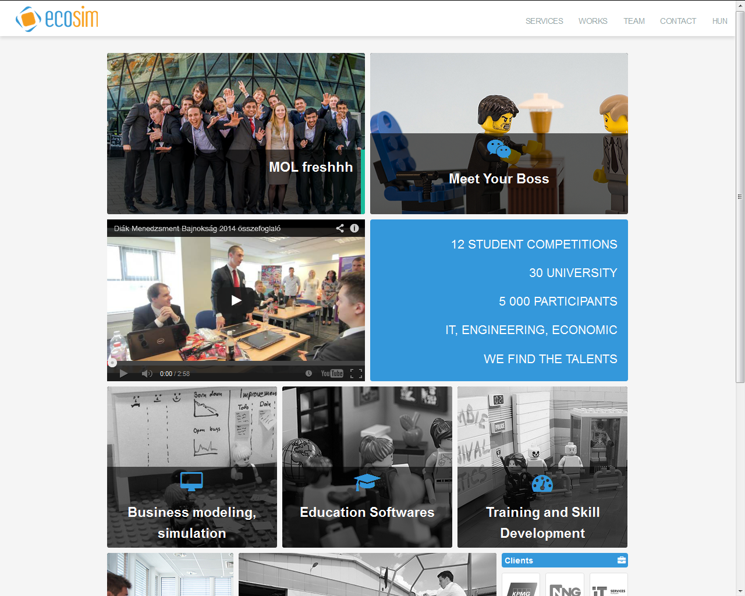

Slide 14
EcoSim engineer competitions
www.freshhh.net www.unitechverseny.hu www.conticup.hu www.flexcellence.hu
Freshhh: 6 200 participants, 70 countries, oil industry online simulation and case study
CLAAS UniTech Engineering Students’ Competition: 100 participants, plan & construction
ContiCup: 350+ participants, case study, quiz & presentation
Xcellence: 250-400 participants, engineers’ quiz & case study competition
14

Slide 15
References – clients
15

Slide 16
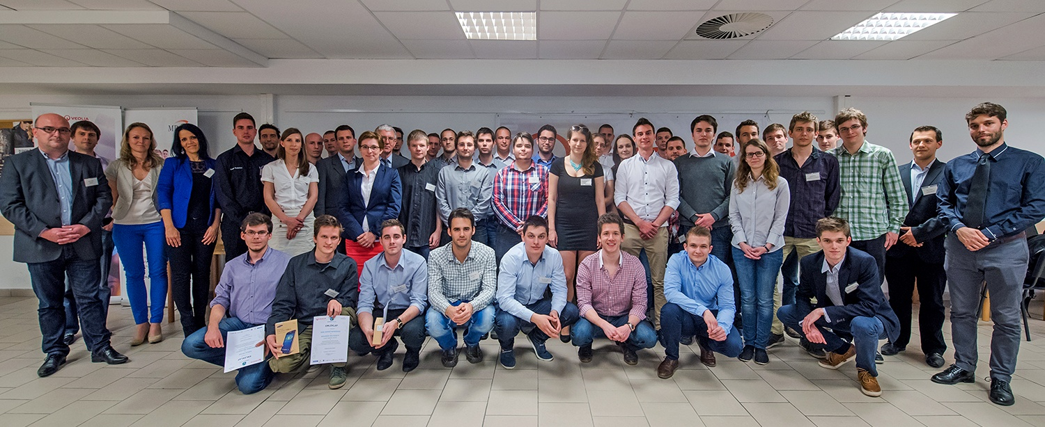
Balázs Orova
Sales & Marketing
EcoSim Student Competitions
+36302971690
balazs.orova@ecosim.hu
www.ecosim.hu
16

